Slide 1
Matrix Calculator
Abdullah Khadim CT-25083
Syed Mateen Ali CT-25084
Bushra Abid CT-25057

Slide 2
Contents
What is matrix and what are operations performed on it
How it helps in our daily lives
Its use in Computer Science and real world
Explaining Operations
Algorithm and Flowchart
Tools in C used for it
How we make those operations in C language
The Program

Slide 3
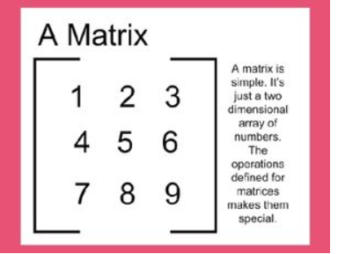
Matrix
A matrix is a rectangular array of numbers, symbols, or expressions arranged in rows and columns, typically enclosed in square brackets. The numbers are called the elements or entries of the matrix, and the arrangement is used to represent data and solve systems of linear equations. A matrix's size is defined by its number of rows and columns, for example, an “m x n" matrix has “m” rows and “n” columns. for example

Slide 4
Why do we use matrices
Computer science and technology
Computer Graphics: Matrices are used to represent and manipulate objects in 2D and 3D space, including transformations like scaling, rotation, and translation.
Robotics: Robots use matrices to program their movements, calculate navigation, and perform tasks.
Data Encryption: Matrices are used to encrypt and decrypt data, providing security for online transactions and communications.
Page Ranking: Algorithms like the one used by Google use matrices to rank websites based on the links between them

Slide 5
Matrix Operations in CCP
Additon
Subtraction
Multiplication
Transpose
Determinant

Slide 6
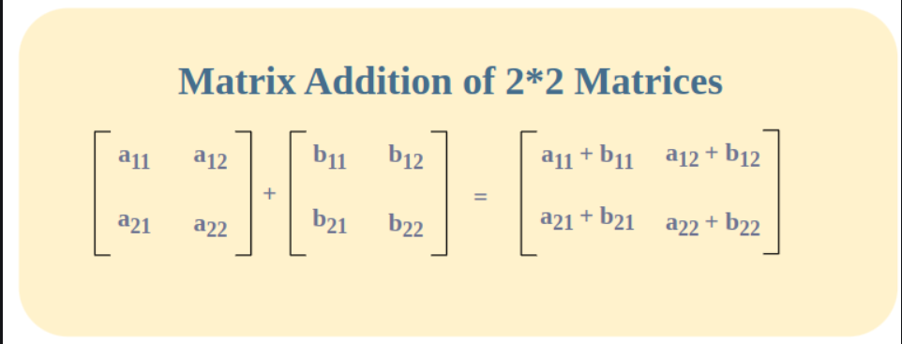
Matrix Addition
The matrices that are to be added must have same order
The elements of the same order are added with each other

Slide 7
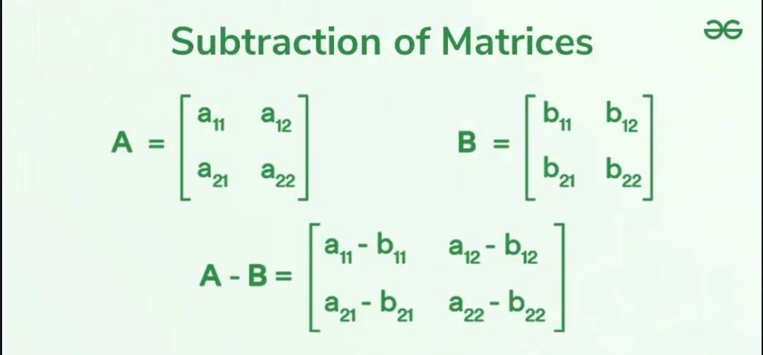
Matrix Subtraction
Same order for both Matrices
Element of same corresponding order will subtract

Slide 8
Matrix Multiplication
The number of columns of first matrix should be same as the number of rows of second matrix.
The multiplication will occur in order of elements of rows of first matrix to be multiplied by elements of columns of second matrix
For example if A(m.n) x B(n.p) then then the product of A and B (matrix C) should be of order (m.p)

Slide 9
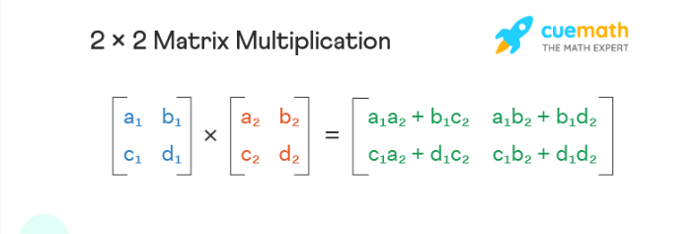
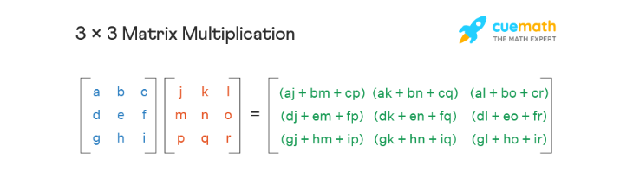
An 2 by 2 matrix multiplication
A 3 by 3 matrix multiplication

Slide 10
Transpose of a Matrix
The matrix formed by swapping the order of elements in rows and columns ultimately swapping the order of matrix.
For example if a matrix A has order of (2x3) then the order of its transpose At will be (3x2)
The element at (2,1) will be at (1,2)

Slide 11
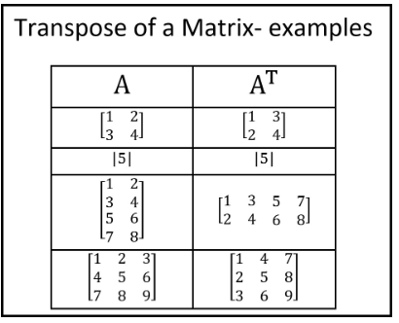
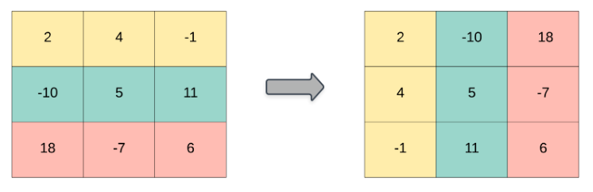
Transpose Operation

Slide 12
Determinant of a Matrix
The determinant is a scalar value computed for a square matrix that we use to find the inverse for matrix and at advance level it indicates properties of the linear transformation it represents, such as scaling factor and orientation.

Slide 13
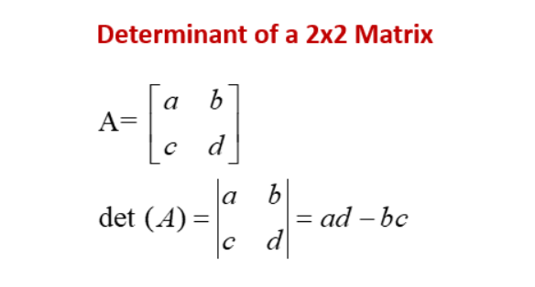
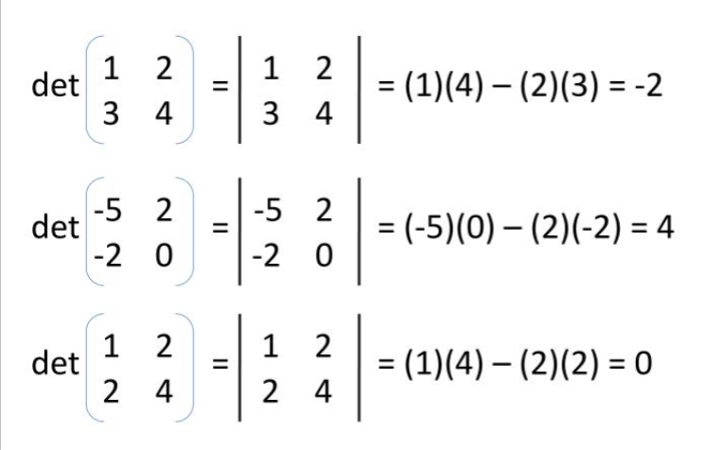
A 2x2 matrix determinant

Slide 14
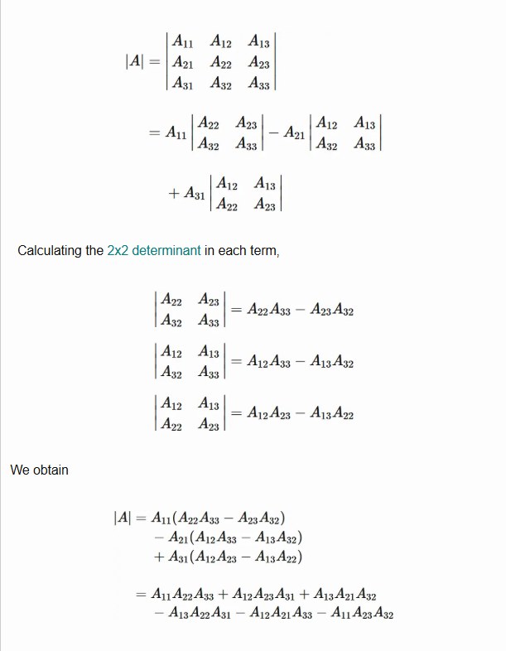
A 3x3 matrix determinant

Slide 15
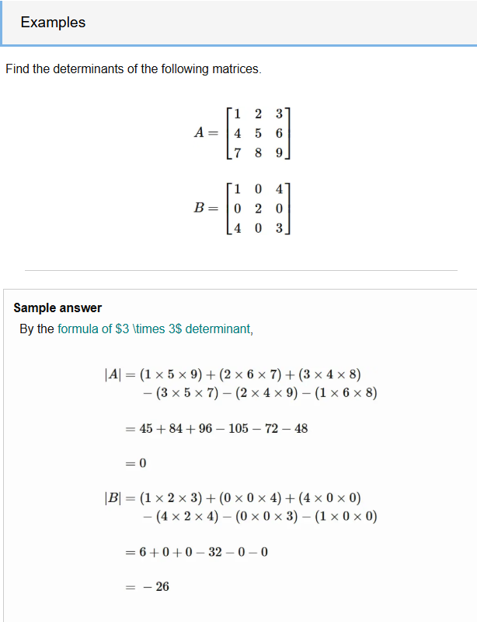

Slide 16
Algorithm
Step 1: Start the program
Step 2: Display the title "Matrix Calculator"
Step 3: Ask the user to enter matrix size (2 or 3)
Step 4: If size is not 2 or 3 → display "Invalid size" and stop
Step 5: Input elements of the first matrix A
Step 6: Input elements of the second matrix B
Step 7: Display both matrices on the screen
Step 8: Show menu for operations:
1 → Addition
2 → Subtraction
3 → Multiplication
4 → Transpose
5 → Determinant
Step 9: Read the user’s choice

Slide 17
Case 1 — Addition
Compute res[i][j] = A[i][j] + B[i][j] for all elements
Display result matrix
Case 2 — Subtraction
Compute res[i][j] = A[i][j] - B[i][j]
Display result matrix
Case 3 — Multiplication
Set all elements of res to 0
For each cell:
res[i][j] = Σ( A[i][k] × B[k][j] )
Display result matrix

Slide 18
Case 4 — Transpose
Print transpose of matrix A: A[j][i]
Print transpose of matrix B: B[j][i]
Case 5 — Determinant
If matrix size is 2×2:
det = a[0][0]*a[1][1] – a[0][1]*a[1][0] for both matrices
If matrix size is 3×3:
Apply standard determinant formula
Display the determinant values
Default
Display “Invalid Choice”
Step 10: End the program

Slide 19
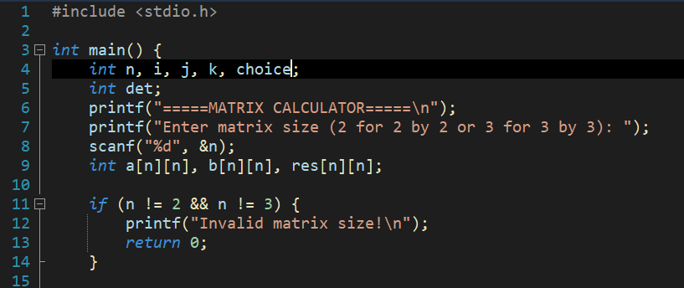
The Program
Setting the size
First we prompt the user to enter the size for the square
matrix. The user will either enter 2 for 2x2 or 3 for 3x3
matrix.
In line 9 the compiler itself will set the size according to
User input. If the user enter any other number it will
Simply give the statement “Invalid matrix size”.

Slide 20
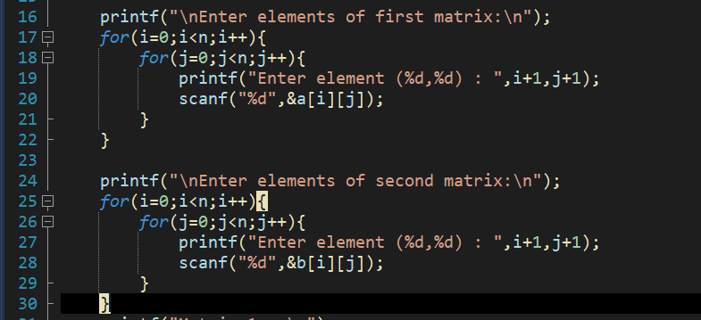
Declaring the elements
For declaring elements for matrix a and b we use two nested for loops the first loop is for the rows and the inner loop is for columns
i | j | a[i][j]
0 | 0 | a[0][0]
0 | 1 | a[0][1]
0 | 2 | a[0][2]
1 | 0 | a[1][0]
1 | 1 | a[1][1]

Slide 21
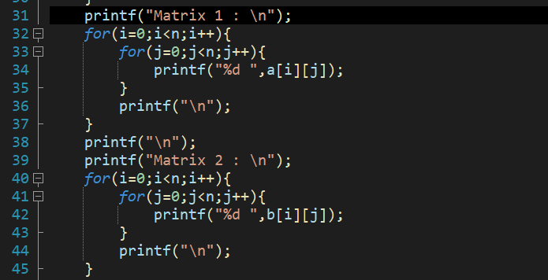
Showing the Matrices
In these two nested for loops we display the
Elements in matrix like format with only difference
bieng the ‘\n’ operator after the inner loop ends.
This is the trick for making that matrix format
A[i][j] | New line
A[0][0]
A[0][1]
A[0][2]
 | \n
A[1][0]

Slide 22
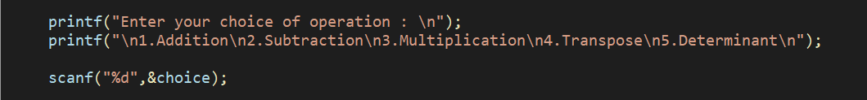
Operations
After displaying the matrices we ask the user to
Enter number corresponding to the operations
In the program user will enter 1 for addition or 2 For subtraction and so on. After the user make the choice we use the switch statement which contains the operations as cases

Slide 23
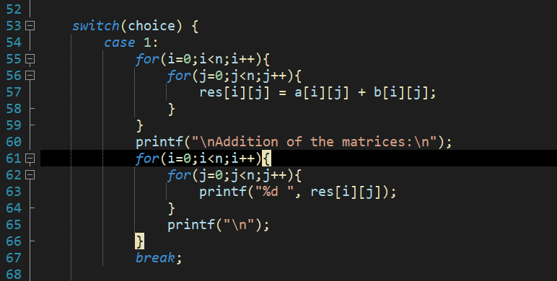
Addition
A[i][j] | B[i][j] | Res[i][j]
A[0][0]=1 | B[0][0]=3 | Res[0][0] = 4
A[0][1]=8 | B[0][1]=6 | Res[0][1] = 14
A[0][2]=4 | B[0][2]=5 | Res[0][2] = 9
A[1][0]=2 | B[1][0]=4 | Res[1][0] = 6
a[1][1]=8 | B[1][1]=6 | Res[1][1] = 14

Slide 24
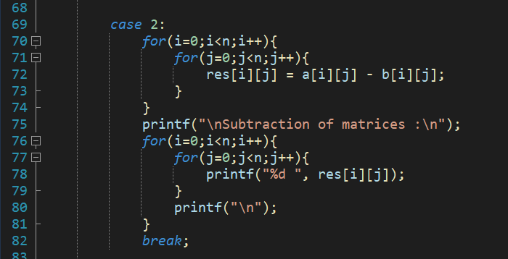
Subtraction
A[i][j] | B[i][j] | Res[i][j]
A[0][0] = 1 | B[0][0] = 3 | Res[0][0] = -2
A[0][1] = 8 | B[0][1] = 6 | Res[0][1] = 2
A[0][2] = 4 | B[0][2] = 5 | Res[0][2] = -1
A[1][0] = 2 | B[1][0] = 4 | Res[1][0] = -2
A[1][1] = 8 | B[1][1] = 6 | Res[1][1] = 2

Slide 25
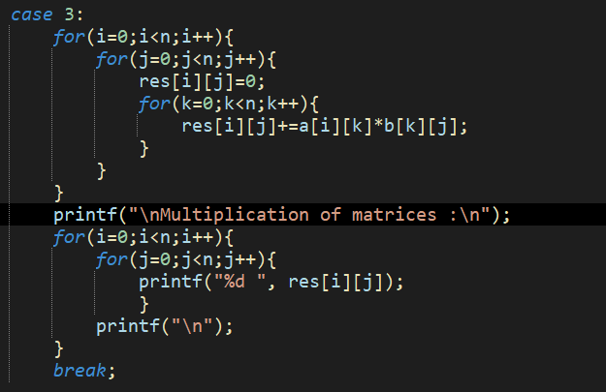
Multiplication
For Multiplication we use 3 loops
First loop is for each row of matrix a the second loop is for the columns of matrix b the third loop is for multiplying a and b and saving it to the resultant matrix
We set resultant matrix to zero before multiplying to avoid saving garbage value from previous calculations
The multiplication will occur from multiplying the elements of
Matrix a row wise to elements of matrix b column wise and add them.
Eg res[0][0] = 0 + a[0][0] x b[0][0];
res[0][0] = a[0][0] x b[0][0] + a[0][1] x b[1][0];
res[0][0] = a[0][0] x b[0][0] + a[0][1] x b[1][0] + a[0][2] x b[2][0];
After multiplying we use another nested for loop to display the
Multiplied matrix

Slide 26
A[i][k] | B[k][j] | Res[i][j]
A[0][0] | B[0][0] | Res[0][0] = A[0][0]*B[0][0]
A[0][1] | B[1][0] | Res[0][0] = A[0][0]*B[0][0] +A[0][1]*B[1][0]
A[0][2] | B[2][0] | Res[0][0] = A[0][0]*B[0][0] +A[0][1]*B[1][0] + A[0][2]*B[2][0]
A[0][0] | B[0][1] | Res[0][1] = A[0][0]*B[0][1]
A[0][1] | B[1][1] | Res[0][1] = A[0][0]*B[0][1] +A[0][1]*B[1][1]

Slide 27
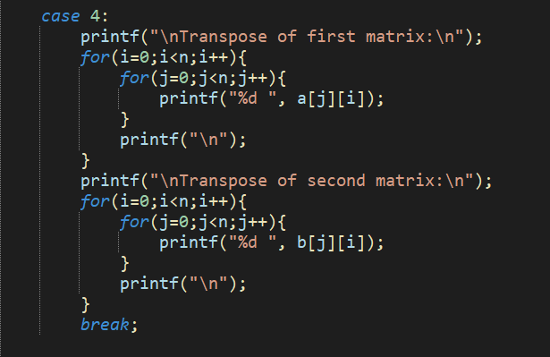
Transpose
For transposing we again use the two nested for displaying the transpose of both matrices the method to display the transpose is to simply change the order of matrix a[i][j] and b[i][j] to a[j][i] and b[j][i] .This will swapp
The elements from row to columns and vice versa
A[i][j] | B[i][j] | Output 1 | Output 2
A[0][0] | B[0][0] | A[0][0] | B[0][0]
A[0][1] | B[0][1] | A[1][0] | B[1][0]
A[0][2] | B[0][2] | A[2][0] | B[2][0]

Slide 28
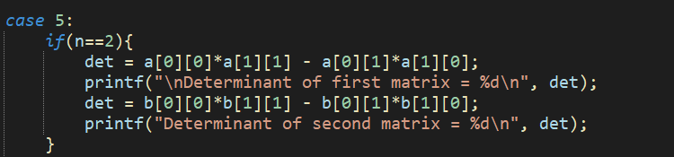





Determinant (2x2)
For finding determinant we use an if else statement if first if n == 2 then For 2 by 2 matrix we simply multiply the elements from 2 diagonals and subtract them
In this case a[0][0] = 2, a[1][1] = 8 , a[0][1] = 4 and a[1][0] = 7
So det = a[0][0]*a[1][1] – a[0][1]*a[1][0] = 16-28 = -12

Slide 29
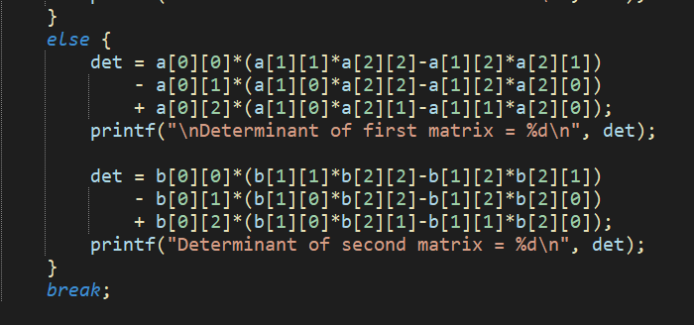
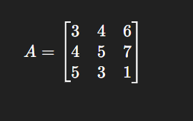
Determinant (3x3)
If n is not 2 then it will probably be 3 so we calculate the 3x3 determinant in else statement. For 3x3 determinant we chose a number ‘a’ then find 2x2 matrix of only those elements which are not in the same row or column as ‘a’ and then we multiply the determinant by ‘a’

Slide 30
A[0][0] = 3
A[0][1] = 4
A[0][2] = 6
A[1][0] = 4
A[1][1] = 5
A[1][2] = 7
A[2][0] = 5
A[2][1] = 3
A[2][2] = 1
a[0][0]*(a[1][1]*a[2][2]-a[1][2]*a[2][1]) = 3x(5x1-7x3) = 3(5-21) = 3(-16) = -48
- a[0][1]*(a[1][0]*a[2][2]-a[1][2]*a[2][0]) = 4x(4x1-7x5) = 4(4-35) =-4(-31) = 124
+ a[0][2]*(a[1][0]*a[2][1]-a[1][1]*a[2][0]) = 6(4x3-5x5) = 6(12-25) =6(-13) = -78
Det = -48 + 124 - 78 = -2

Slide 31
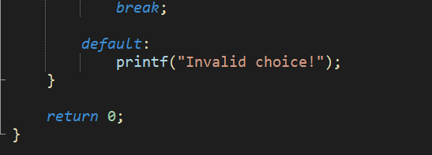
The End
In the end we have default statement that if choice dosent matches any case it displays the invalid choice and our program ends

